Slide 1

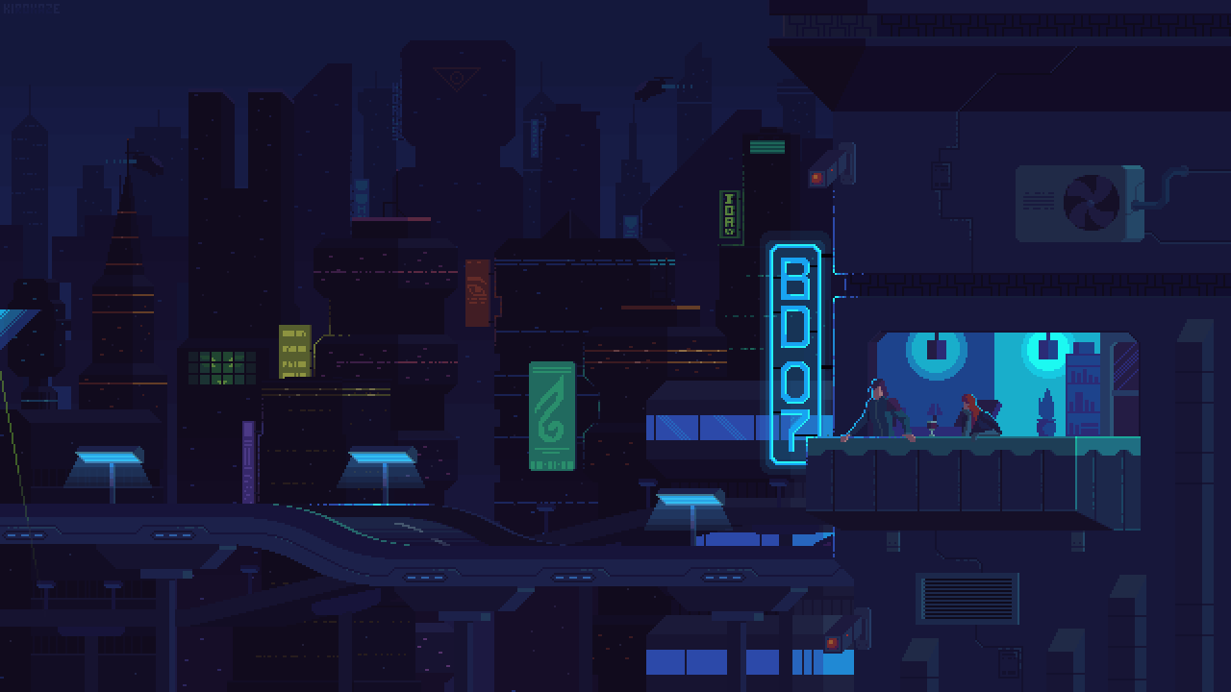
MINI PROJECT PRESENTATION
PRESENTED
BY
TEAM
CYPHER AUGMENTORS

Slide 2
TEAM MEMBERS
Moirangthem Daniel Singh
Reagan Sagolsem
Barlin Chongtham
Meinam Ashaad

Slide 3
ACKNOWLEDEGEMENT
The Cypher Augmentors are grateful to each of its member for their continued support and the dynamic efforts of the teamwork and their contribution for this presentation

Slide 4
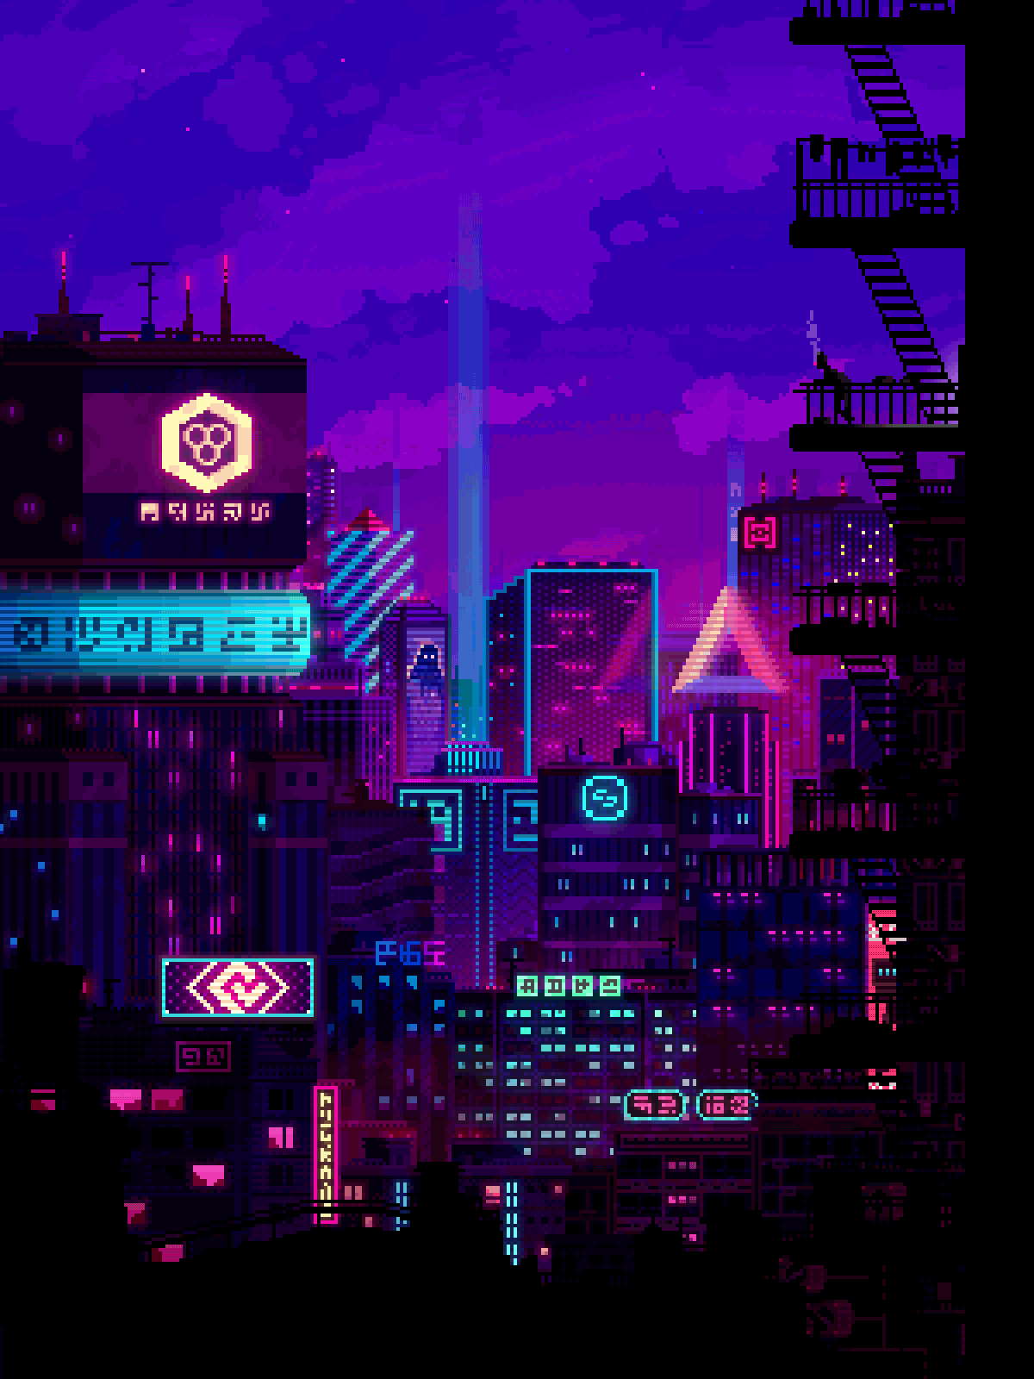
CONTENTS
01
Introduction
02
About our Projects
03
Game Models

Slide 5
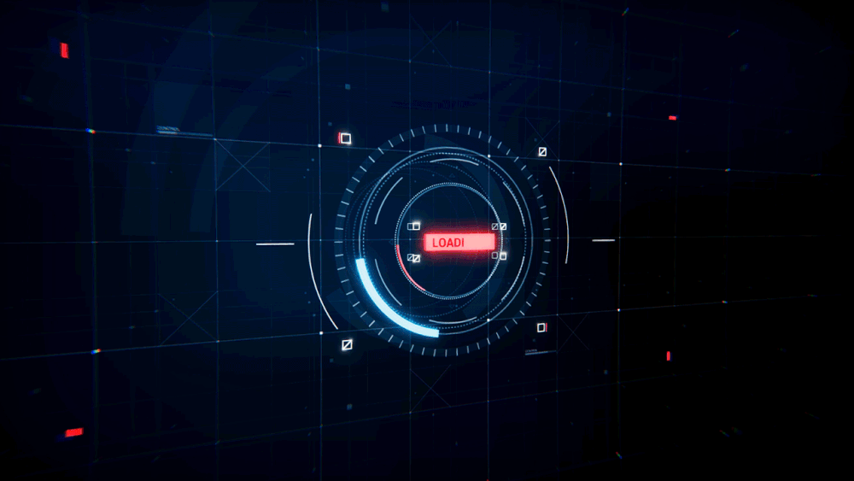
INTRODUCTION 01

Slide 6
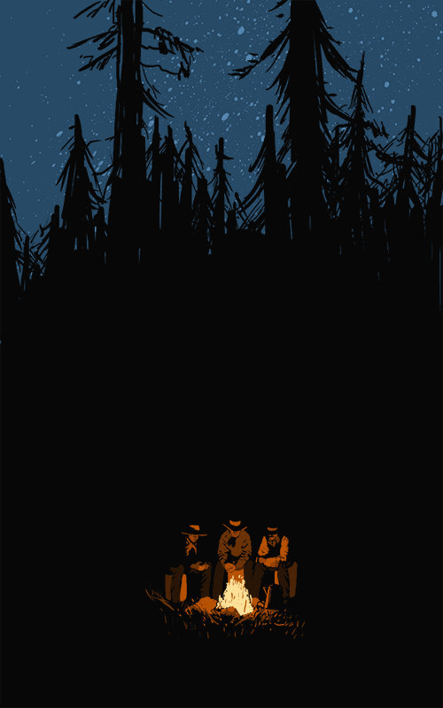
INTRODUCTION
Our project is on Game development
Name of our game is ‘Arithmetic Destination’
The assets were design using photoshop, sketchbook and exported as png file format
The game is made using UNITY game engine
C# programming language was used

Slide 7
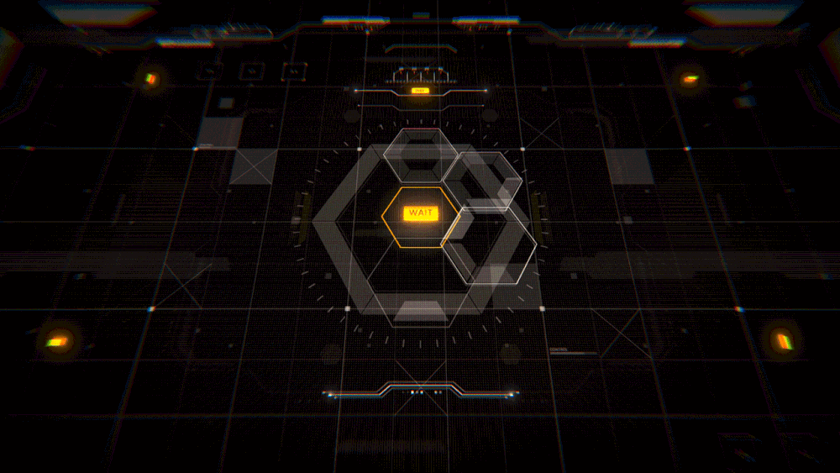
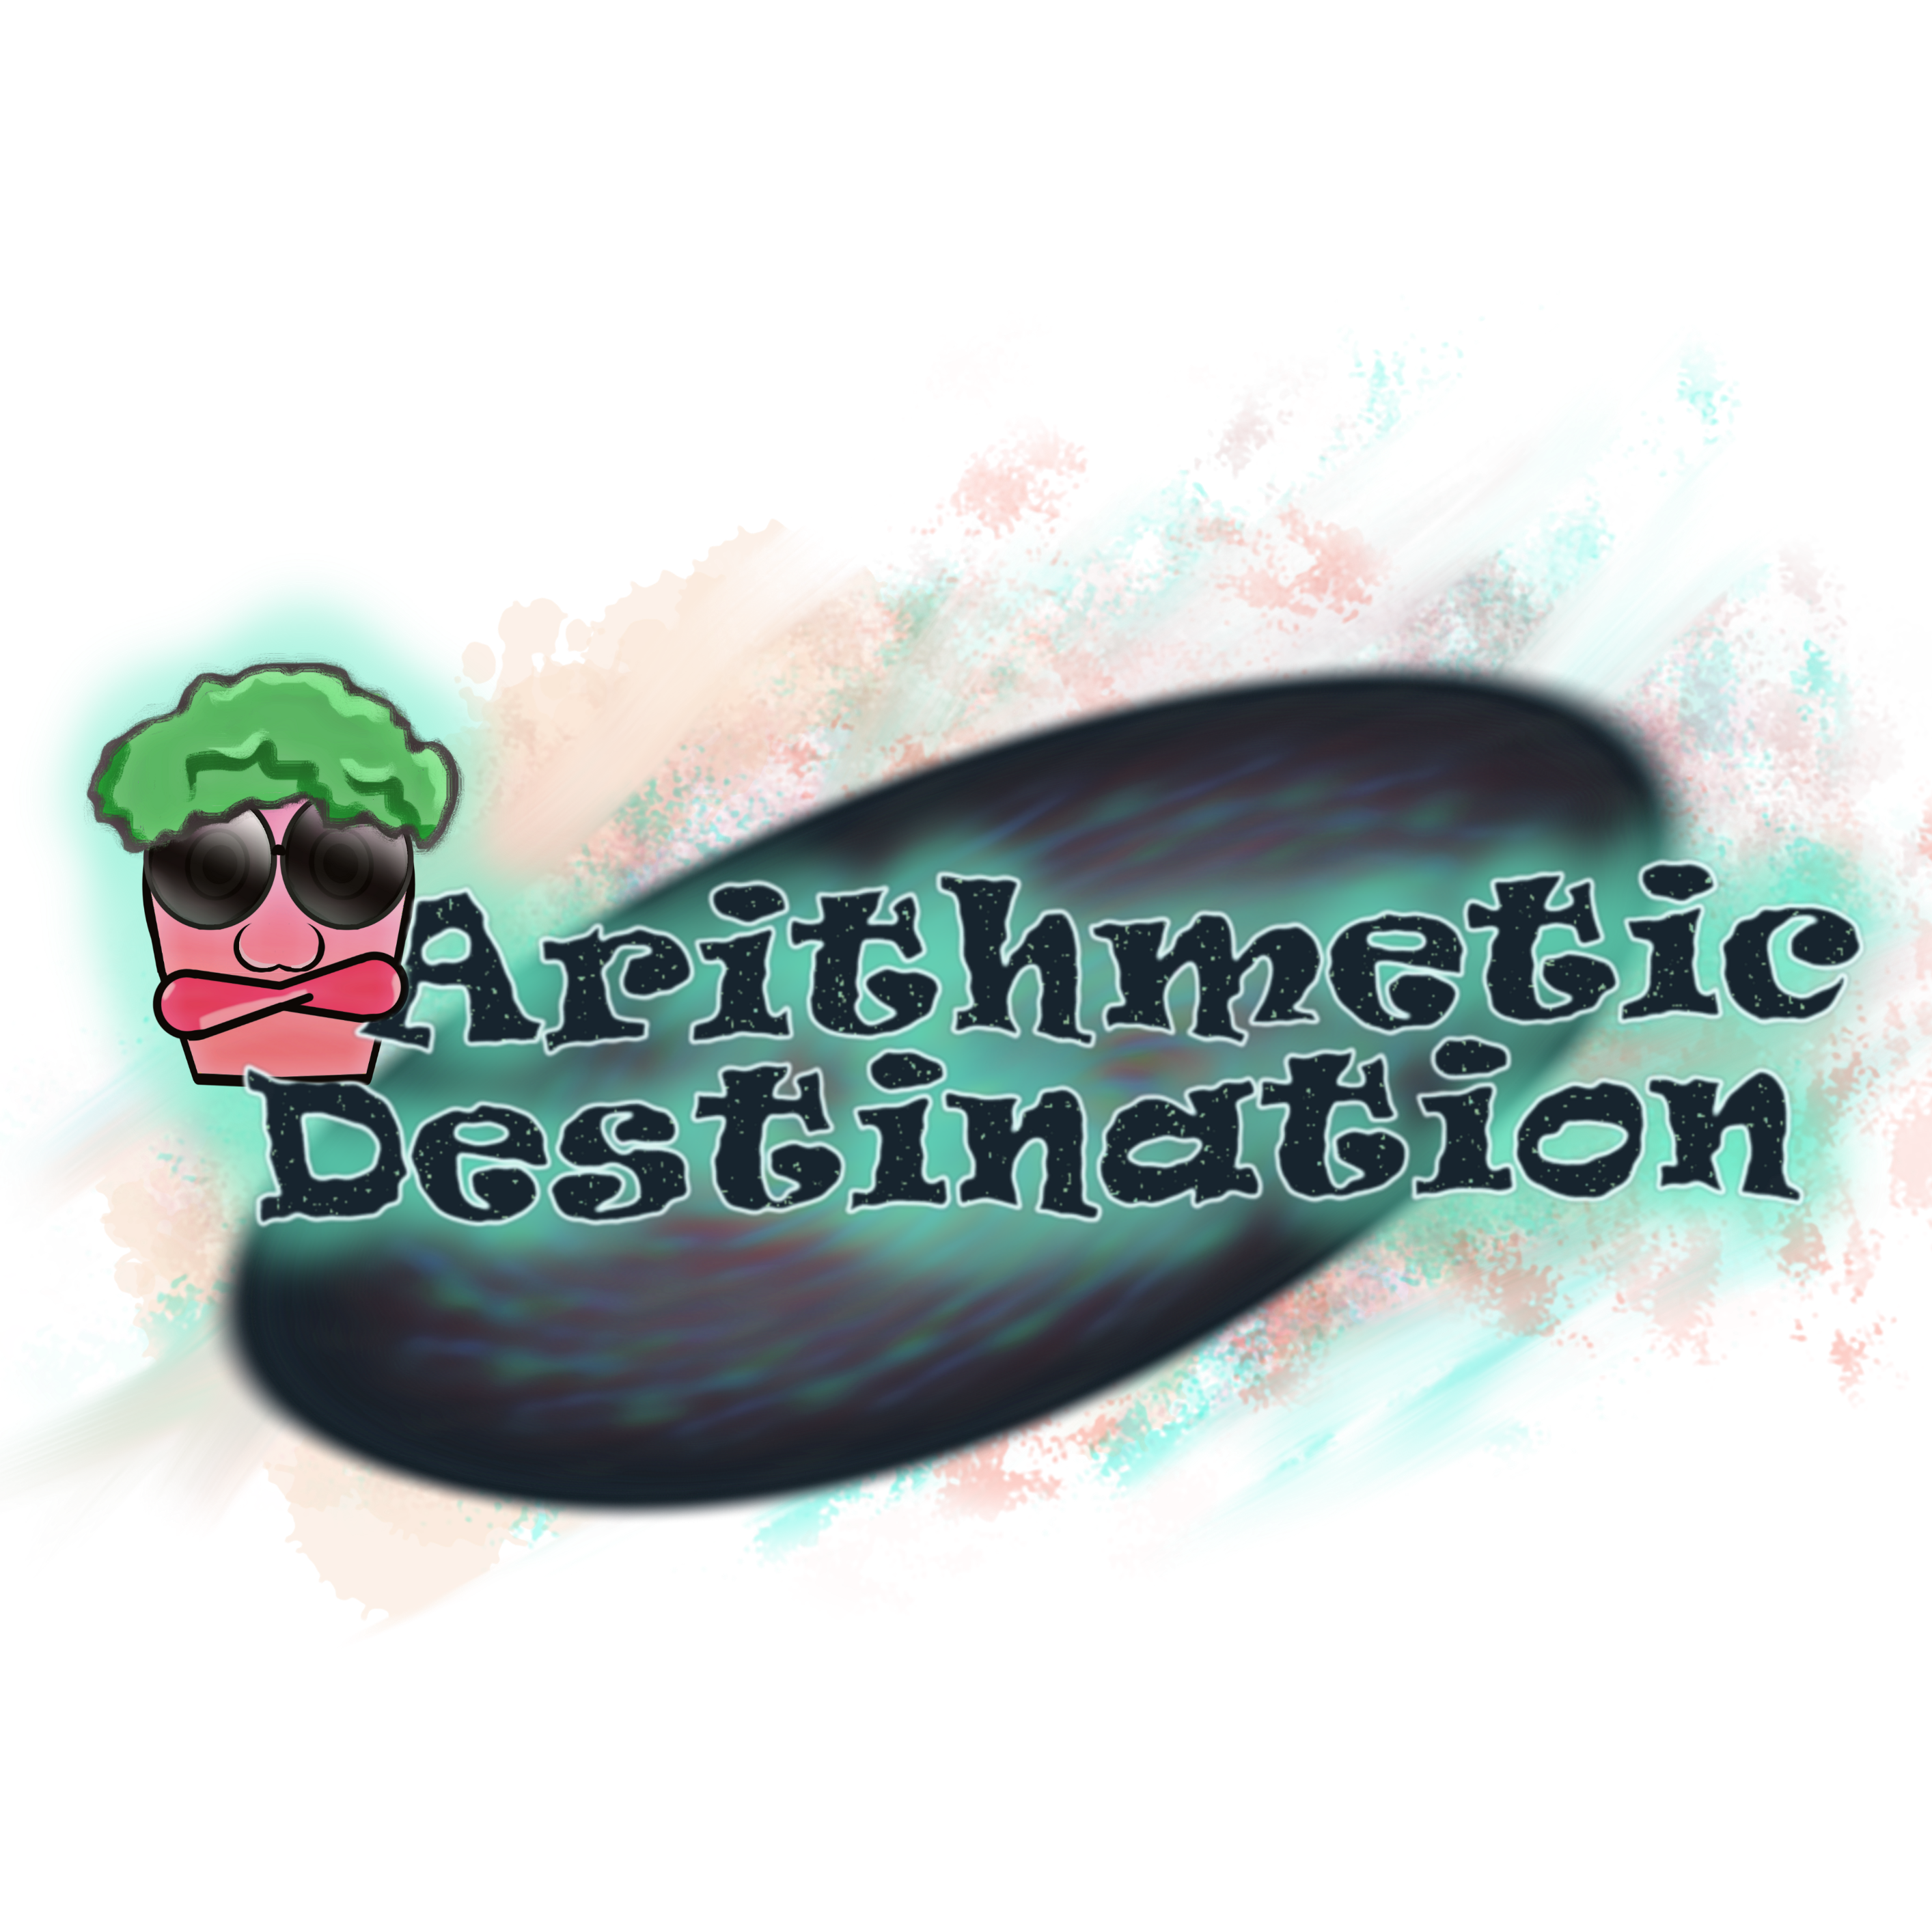
02
About Our Project

Slide 8
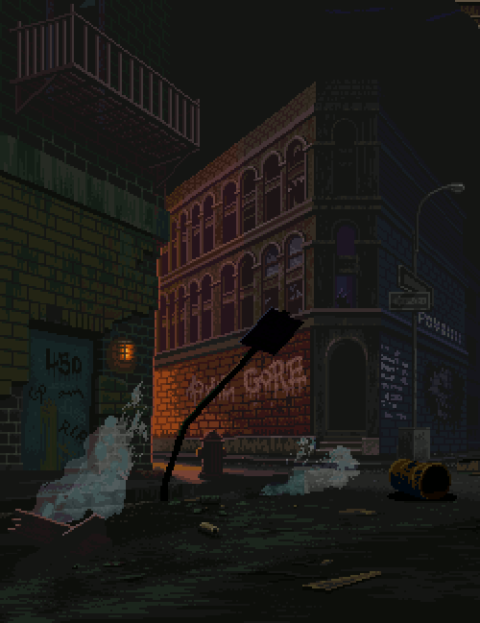
Arithmetic Destination
It is a 2D tile based game that is based on Arithmetic calculation .
The players are suppose to safely move and bring our cute character to the end by avoiding the traps along the way.
We aim to improve our user’s speed of thinking as we added timer and each moves were to be calculated using calculator, making it more challenging and interesting

Slide 9
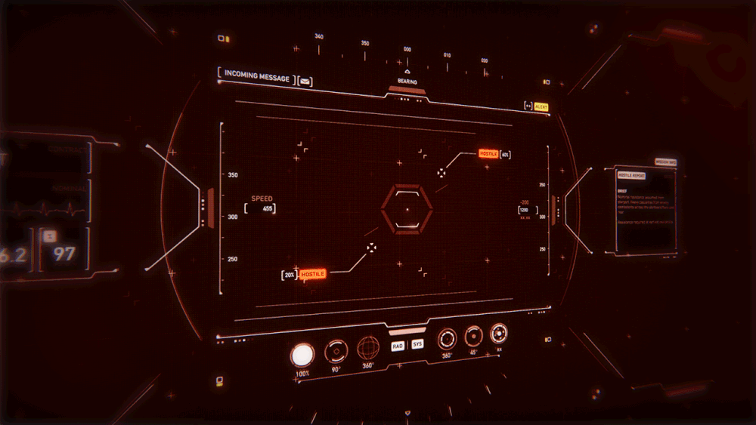
03
GAME MODELS

Slide 10

Game Icon
Character
Death Animation

Slide 11
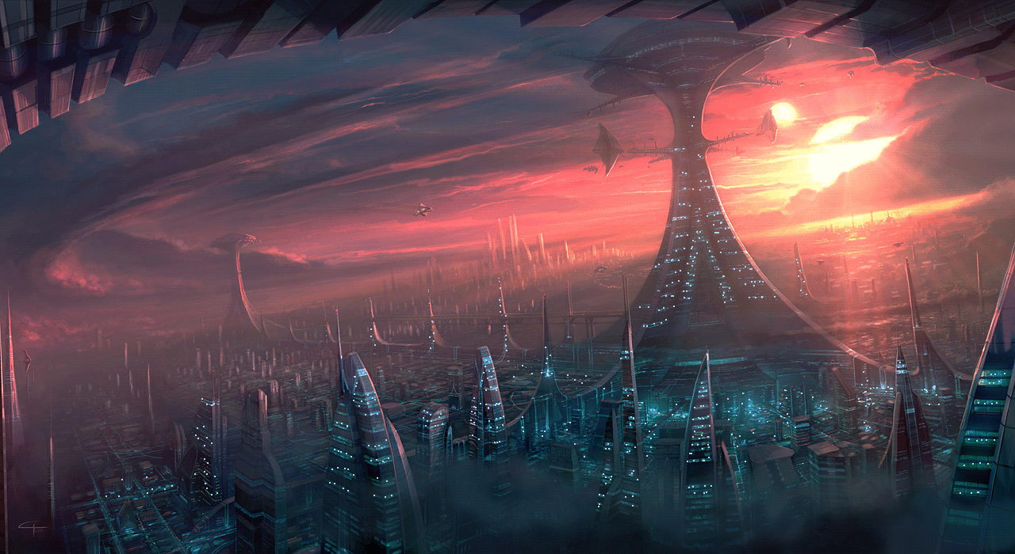
How the game works
The game Character will be moved accordingly to the calculated result assign by the Player.

Slide 12




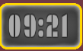



Game Assets
Pit Trap
Spikes Trap
Walls
Water
Display entered Text
Heath Bar
Predict Results/Detele Button
Timer

Slide 13
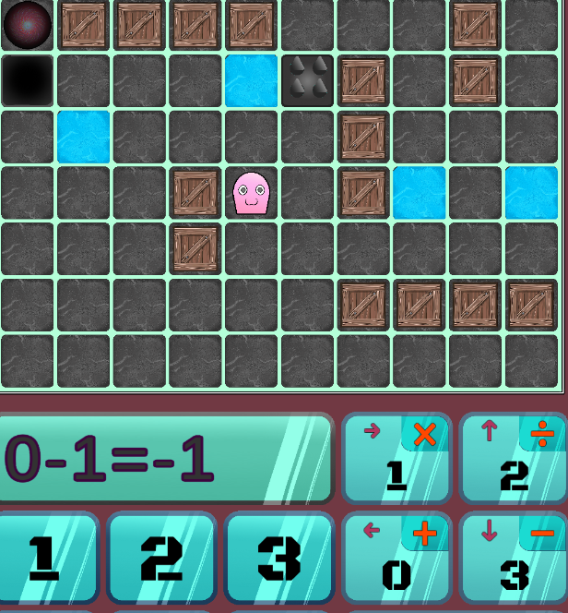


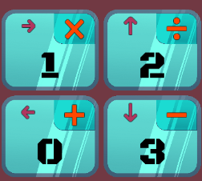
Game Assets
=
X
Direction
Equal
Detector
Detection Location:

Slide 14
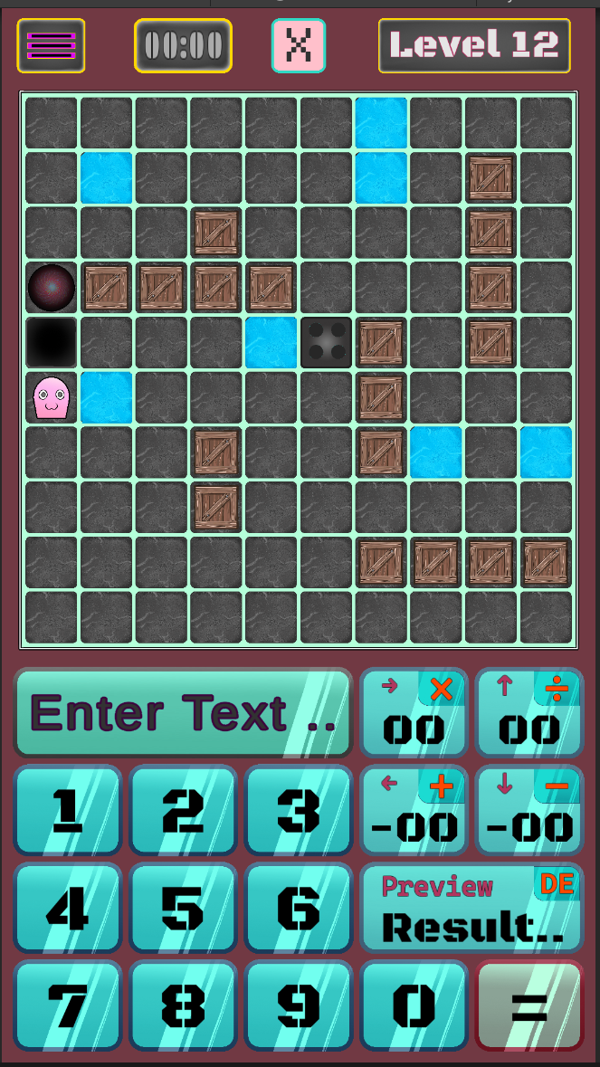
Game Preview Sample

Slide 15


